Slide 1



SIMATS ENGINEERING
Movie Ticket Booking System using Queue
CSA 0303 – Data Structures
CAPSTONE REVIEW – 1
Presented by:
M. Rumana Khan (192471025)
S. Harinika (192521444)
Guided by:
Dr. T. Rajesh Kumar

Slide 2
Introduction
Develops an efficient Movie Ticket Booking System using queue-based data structures.
Processes booking requests in the order they are received.
Uses Circular Queue for continuous booking requests.
Uses Priority Queue to provide faster booking access to premium members.
Uses Linked List Queue to manage cancellations and waitlisted users.
Helps prevent double booking and reduces customer waiting time.

Slide 3
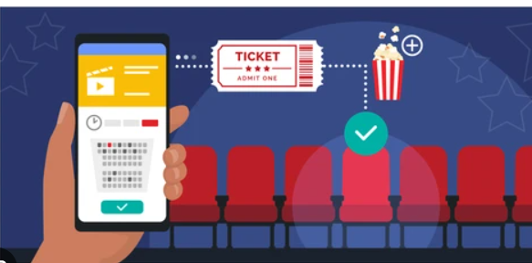
Problem Statement
During online ticket booking, many users try to reserve seats at the same time. This can cause:
Double booking of seats
Unfair booking order
Difficulty managing cancellations
Poor experience for premium members
The system should process bookings fairly while handling cancellations efficiently.

Slide 4
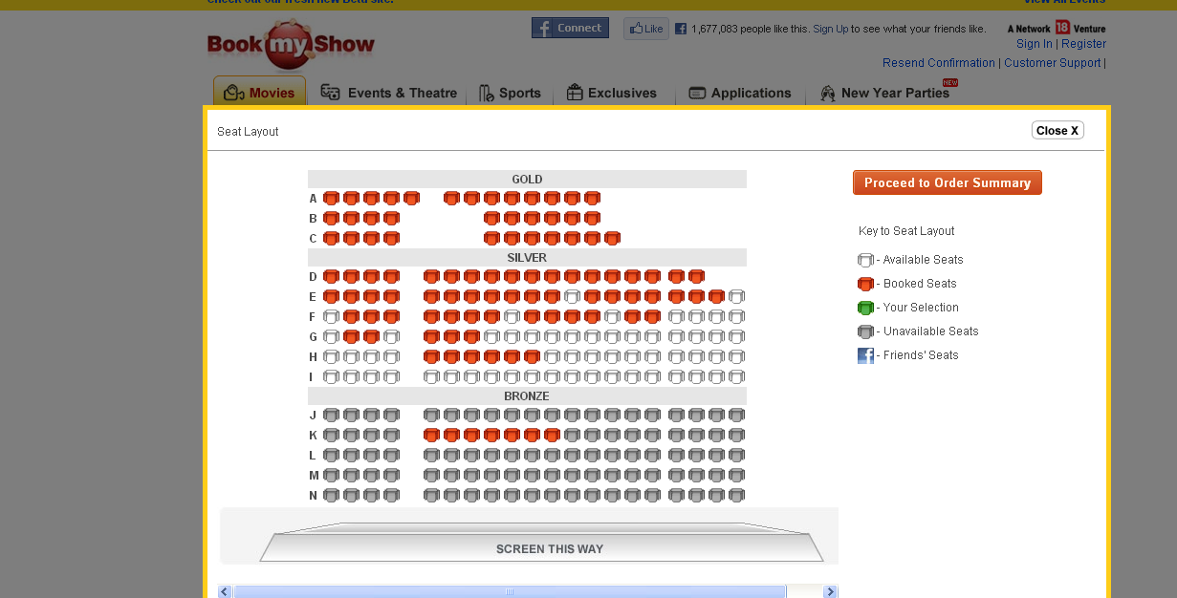
Objectives
Process booking requests in the order they are received.
Prevent double booking during high traffic.
Automatically assign cancelled seats to waitlisted users.
Provide faster booking access for loyalty members

Slide 5
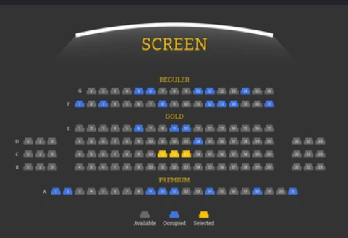
Module 1: Seat Reservation &
Priority Booking
Functions :
Accept booking requests.
Process seat selections in chronological order.
Maintain a separate priority queue for premium members.
Follow a 3 Premium : 1 General booking ratio.
Data Structures Used :
Circular Queue
Priority Queue

Slide 6
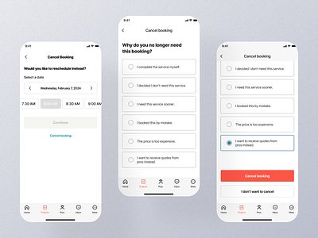
Module 2: Cancellation & Waitlist
Management
Functions :
Handle ticket cancellations.
Maintain waitlisted users.
Automatically allocate cancelled seats to the first user in the waitlist.
Keep booking records updated.
Data Structure Used :
Linked List Queue

Slide 7
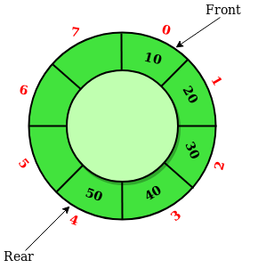
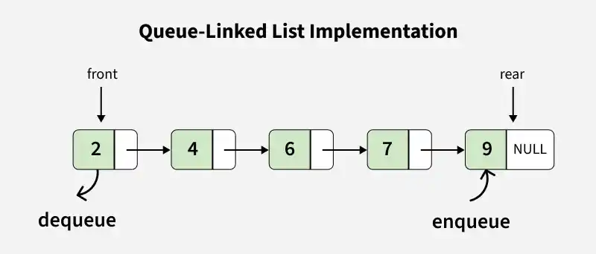
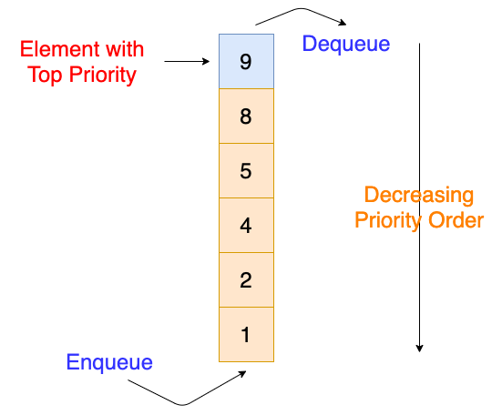
Data Structures Used
Circular Queue :
Handles continuous booking requests.
Supports O(1) enqueue and dequeue operations.
Linked List Queue :
Maintains dynamic waitlist.
Easy insertion and deletion.
Priority Queue :
Gives faster access to premium members.
Supports ratio-based booking (3 Premium : 1 General).

Slide 8
Expected Outcomes
Fair and chronological seat booking.
Prevention of double booking during peak hours.
Automatic seat allocation from waitlist after cancellations.
Maximum theater occupancy through efficient back-filling.
Faster booking experience for premium members.
Improved customer satisfaction and reduced waiting time.

Slide 9
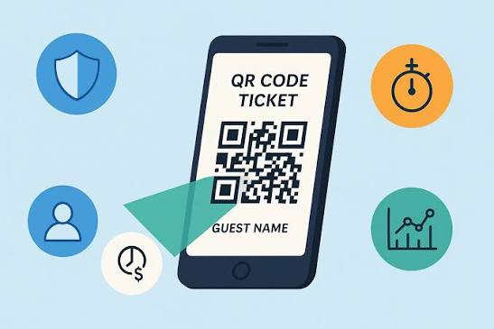
Future Enhancements
Online payment integration.
QR-code based ticket generation.
AI-based seat recommendations.
Real-time booking analytics dashboard.
Multi-theater booking support.

Slide 10
Conclusion
Provides fair and organized movie ticket booking.Efficiently manages booking, cancellation, and waitlist requests.
Prevents double booking during high-traffic periods.
Automatically assigns cancelled seats to waitlisted users.
Improves seat utilization and customer satisfaction.
Demonstrates the effective use of Circular Queue, Priority Queue, and Linked List Queue.

Slide 11


